Slide 1
Edge Computing Security
RaduD

Slide 2
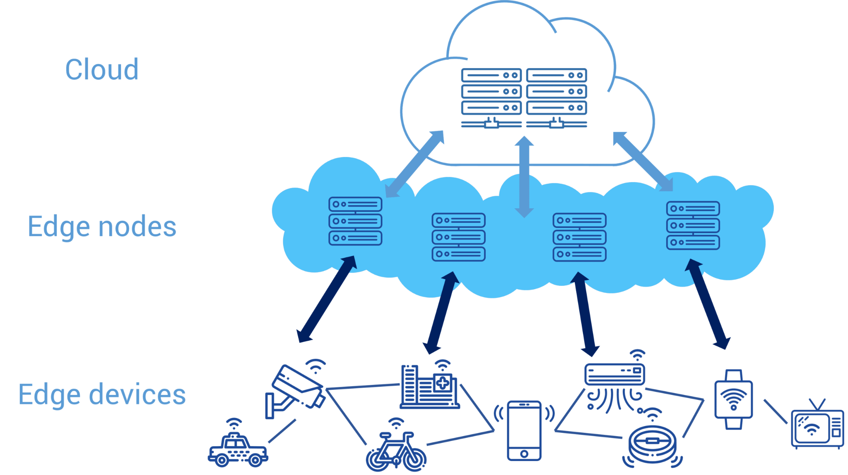
What is edge computing?

Slide 3
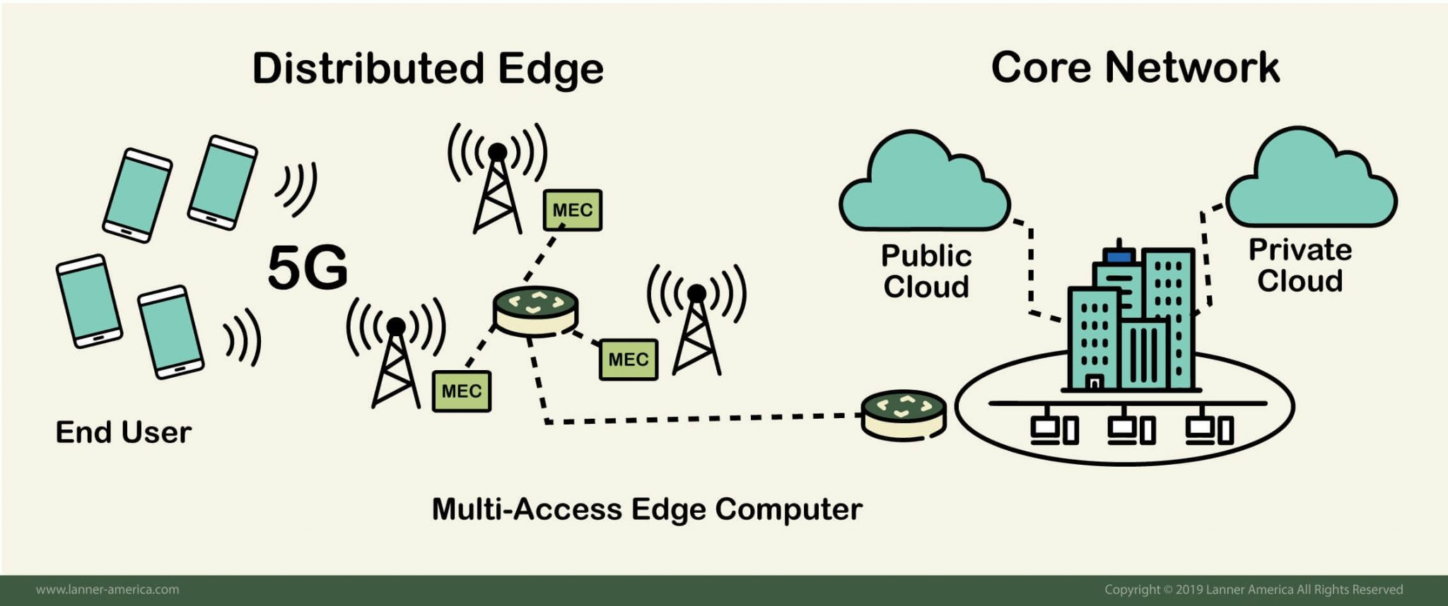
How is Edge Computing related to 5G?

Slide 4

It’s already happening

Slide 5
Security concerns
Physical access to the “edges”
Very high number of devices
Lower capabilities of individual edge devices

Slide 6
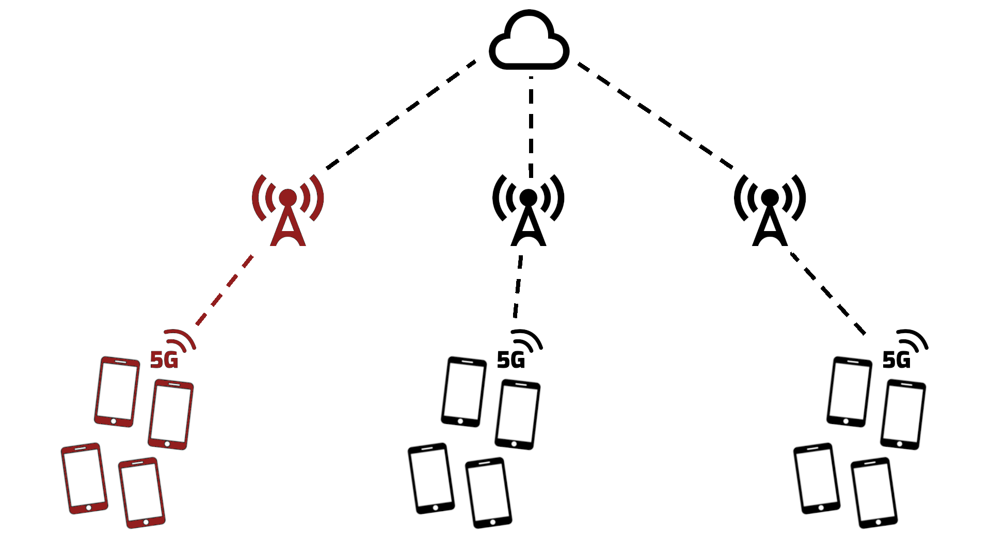
Attack example

Slide 7
Conclusion
Properly securing the edge nodes is quite difficult.
Edge computing has to meet security standards comparable to those of centralised servers, but also provide much greater availability.

